Slide 1
Lending Club Case Study

Slide 2
Data Understanding & Cleaning
Look for the size of the dataFrame, if the dataframe is too lage as it is in our case find the null value columns.
Find out the columns with more then 75% of Null values
After Finding them remove/drop the columns.
It will reduce the columns numbers and make easy to analyze the dataframe

Slide 3
After removing the null value columns remove the columns which are irrelevant to our analysis.
'addr_state', 'emp_title', 'zip_code', 'addr_state', 'delinq_2yrs', 'earliest_cr_line', 'inq_last_6mths', 'open_acc', 'pub_rec', 'revol_bal', 'revol_bal', 'total_acc', 'out_prncp', 'out_prncp_inv', 'total_pymnt', 'total_pymnt_inv', 'total_rec_prncp', 'total_rec_int', 'total_rec_late_fee', 'recoveries', 'collection_recovery_fee', 'last_pymnt_d', 'last_pymnt_amnt', 'last_credit_pull_d', 'application_type‘ etc.

Slide 4
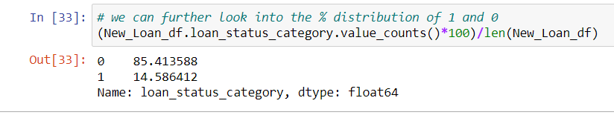
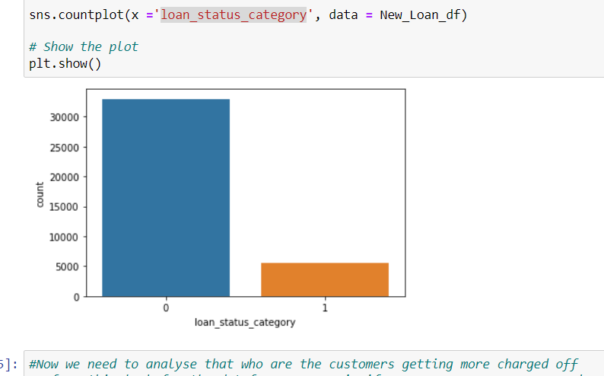

Slide 5
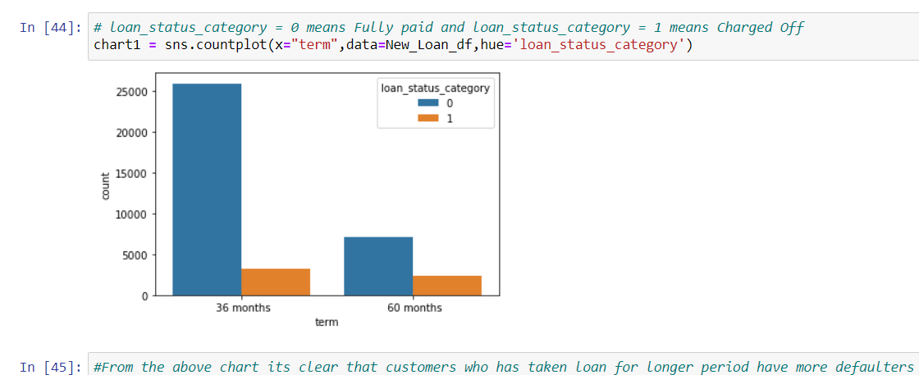

Slide 6
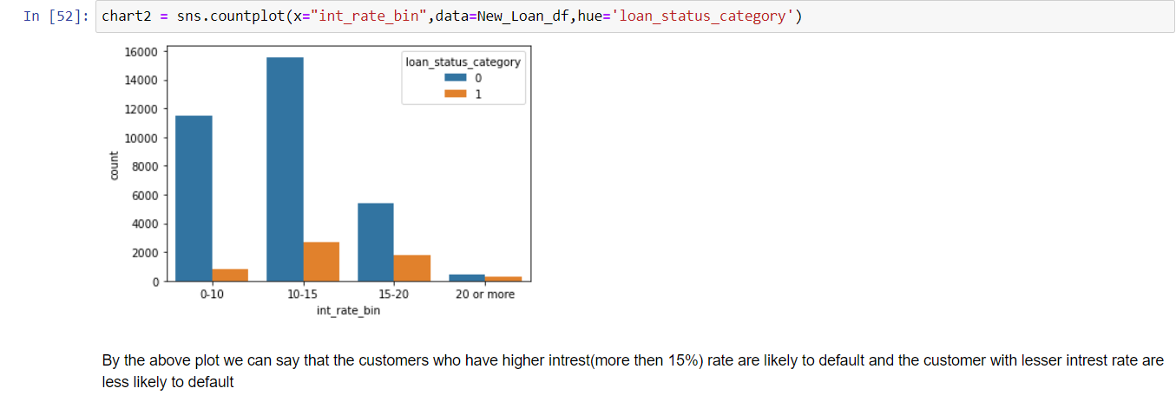

Slide 7
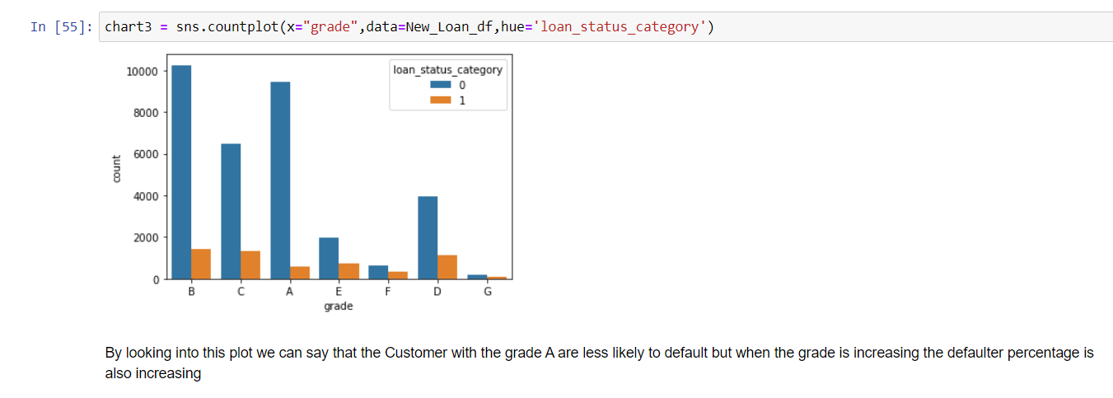

Slide 8
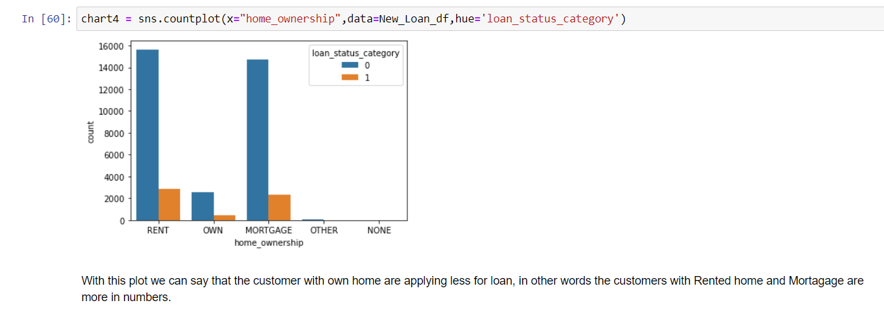

Slide 9
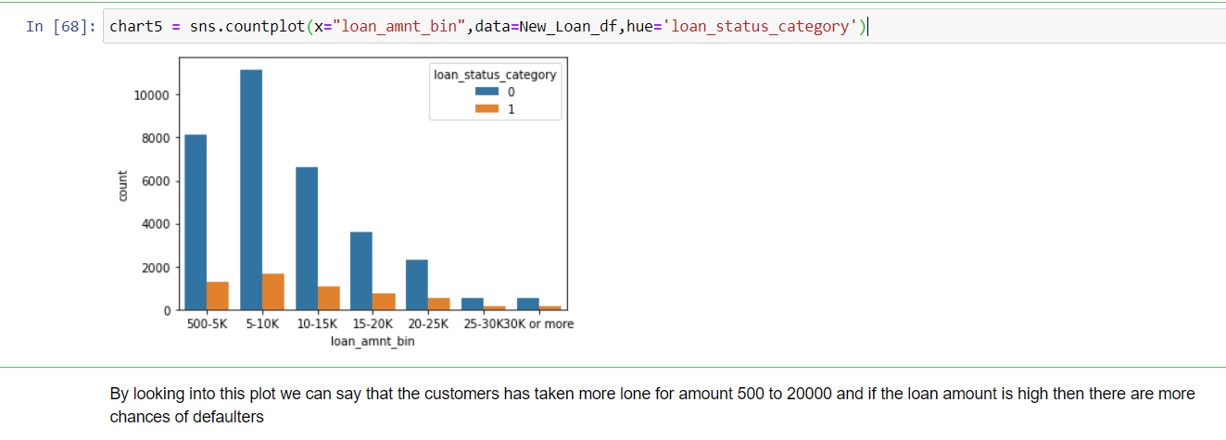

Slide 10
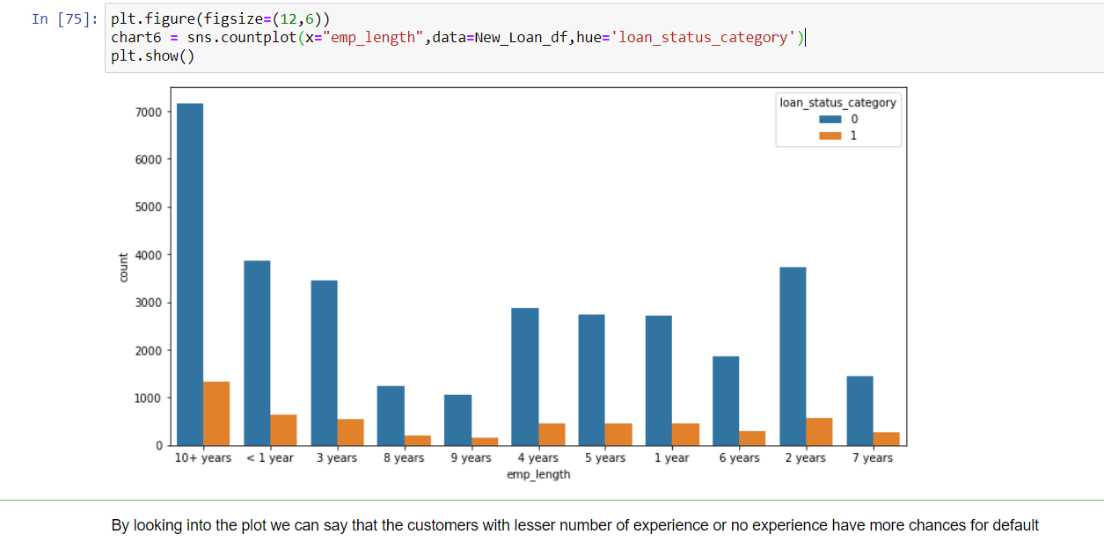

Slide 11
